Slide 1
Embedded Operating Systems
4.2 Virtual Memory
Shripad V Deshpande

Slide 2
Motivation
Virtual memory (VM): A technique using main memory as a “cache” for secondary storage (disk).
Consider a collection of programs is simultaneously running on a computer.
The total required memory is much larger than the amount of main memory.
Main memory needs to contain only the active portions of the programs.
The principle of locality applies.

Slide 3
Locality
Temporal locality: Addresses that are referenced at some time Ts will be accessed in the near future (Ts + delta_time) with high probability. Example : Execution in a loop.
Spatial locality: Items whose addresses are near one another tend to be referenced close together in time. Example: Accessing array elements.
How can we exploit this characteristics of programs? Keep only the current locality in the main memory. Need not keep the entire program in the main memory.

Slide 4
Locality and Virtual Memory
Principle of locality of references: memory references within a process tend to cluster
Hence: only a few pieces of a process will be needed over a short period of time
Possible to make intelligent guesses about which pieces will be needed in the future
This suggests that virtual memory may work efficiently (ie: trashing should not occur too often)

Slide 5
MMU (Memory Management Unit)
The hardware base that makes a virtual memory system possible.
Allows software to reference physical memory by virtual addresses, quite often more than one.
It accomplishes this through the use of page and page tables.
Use a section of memory to translate virtual addresses into physical addresses via a series of table lookups.
The software that handles the page fault is generally part of an operating system and the hardware that detects this situation.

Slide 6
Segmentation……
Segmentation involves the relocation of variable sized segments into the physical address space.
Generally these segments are contiguous units, and are referred to in programs by their segment number and an offset to the requested data.
Efficient segmentation relies on programs that are very thoughtfully written for their target system.
Since segmentation relies on memory that is located in single large blocks, it is very possible that enough free space is available to load a new module, but can not be utilized.
Segmentation may also suffer from internal fragmentation if segments are not variable-sized, where memory above the segment is not used by the program but is still “reserved” for it.

Slide 7
Paging……
Paging provides a somewhat easier interface for programs, in that its operation tends to be more automatic and thus transparent.
Each unit of transfer, referred to as a page, is of a fixed size and swapped by the virtual memory manager outside of the program’s control.
Instead of utilizing a segment/offset addressing approach, as seen in segmentation, paging uses a linear sequence of virtual addresses which are mapped to physical memory as necessary.
Due to this addressing approach, a single program may refer to series of many non-contiguous segments.
Although some internal fragmentation may still exist due to the fixed size of the pages, the approach virtually eliminates external fragmentation.

Slide 8
Paging……(cont’d)
A technique used by virtual memory operating systems to help ensure that the data you need is available as quickly as possible.
The operating system copies a certain number of pages from your storage device to main memory.
When a program needs a page that is not in maim memory, the operating system copies the required page into memory and copies another page back to the disk.

Slide 9
Characteristics of Paging and Segmentation
Memory references are dynamically translated into physical addresses at run time
a process may be swapped in and out of main memory such that it occupies different regions
A process may be broken up into pieces (pages or segments) that do not need to be located contiguously in main memory
Hence: all pieces of a process do not need to be loaded in main memory during execution
computation may proceed for some time if the next instruction to be fetch (or the next data to be accessed) is in a piece located in main memory

Slide 10
Paging and Segmentation
S.NO | Paging | Segmentation
1. | Fixed size pages | Variable size segments
2. | Page size is determined by hardware. | Segment size decided by user
3. | internal fragmentation. | external fragmentation.
4. | Paging is invisible to the user. | Segmentation is visible to the user.
5. | A page is referred to as a physical unit of information. | A segment is referred to as a logical unit of information.

Slide 11
Process Execution
The OS brings into main memory only a few pieces of the program (including its starting point)
Each page/segment table entry has a present bit that is set only if the corresponding piece is in main memory
The resident set is the portion of the process that is in main memory
An interrupt (memory fault) is generated when the memory reference is on a piece not present in main memory

Slide 12
Process Execution (cont.)
OS places the process in a Blocking state
OS issues a disk I/O Read request to bring into main memory the piece referenced to
another process is dispatched to run while the disk I/O takes place
an interrupt is issued when the disk I/O completes
this causes the OS to place the affected process in the Ready state

Slide 13
Advantages of Partial Loading
More processes can be maintained in main memory
only load in some of the pieces of each process
With more processes in main memory, it is more likely that a process will be in the Ready state at any given time
A process can now execute even if it is larger than the main memory size
it is even possible to use more bits for logical addresses than the bits needed for addressing the physical memory

Slide 14
Virtual Memory: large as you wish!
Ex: 16 bits are needed to address a physical memory of 64KB
let’s use a page size of 1KB so that 10 bits are needed for offsets within a page
For the page number part of a logical address we may use a number of bits larger than 6, say 22 (a modest value!!)
The memory referenced by a logical address is called virtual memory
is maintained on secondary memory (ex: disk)
pieces are brought into main memory only when needed

Slide 15
Virtual Memory (cont.)
For better performance, the file system is often bypassed and virtual memory is stored in a special area of the disk called the swap space
larger blocks are used and file lookups and indirect allocation methods are not used
By contrast, physical memory is the memory referenced by a physical address
is located on DRAM
The translation from logical address to physical address is done by indexing the appropriate page/segment table with the help of memory management hardware

Slide 16
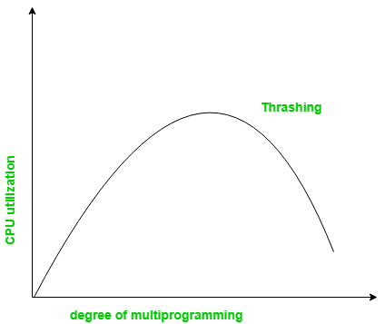
Possibility of trashing
To accommodate as many processes as possible, only a few pieces of each process is maintained in main memory
But main memory may be full: when the OS brings one piece in, it must swap one piece out
The OS must not swap out a piece of a process just before that piece is needed
If it does this too often this leads to trashing:
The processor spends most of its time swapping pieces rather than executing user instructions
Reasons for trashing -high degree of multiprogramming, lack of frames, and incorrect page replacement policy

Slide 17
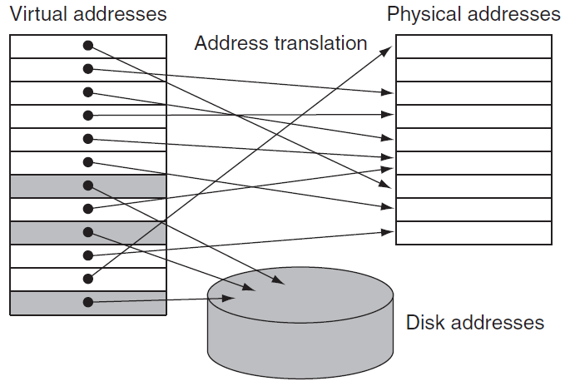
physical pages
virtual pages

Slide 18
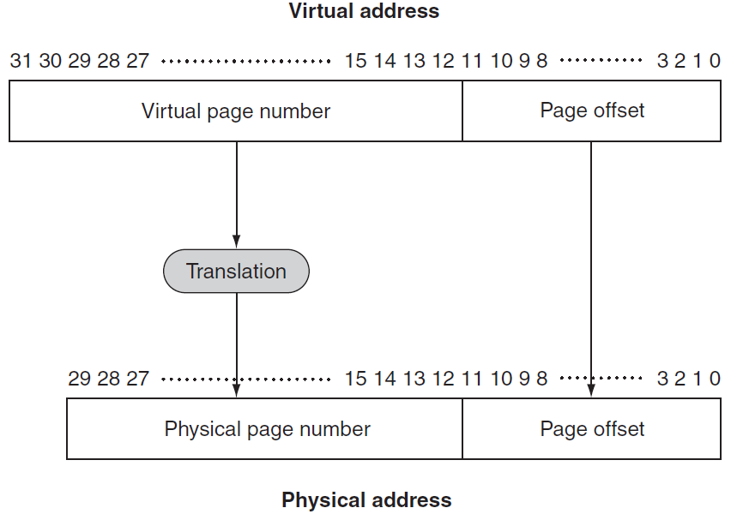
Virtual to Physical Address Mapping
2²⁰ virtual pages
4KB page size
4GB
1GB
2¹⁸ physical pages (frames)
4KB page size (frame)
Illusion of an unbounded amount of virtual memory.

Slide 19
Design choices in VM systems are motivated by the high cost of page fault, taking millions of clock cycles to process.
Pages should be large enough to amortize the high access time. Size ranges from 1 KB (embedded), 16 KB (PC) to 64 KB (servers).
Organizations that reduce the page fault rate, e.g., fully associative placement of pages in memory.
Page faults can be handled in SW because the overhead will be small compared to the disk access time. SW can use smart algorithms for page placement.
Write-through will not work for VM, since writes take too long. VM uses write-back.

Slide 20
Placing a Page and Finding it Again
Reducing page fault frequency is critical due to the high page fault penalty.
The operating system (OS) maps the virtual to any physical page (associative placement of pages).
The OS can use smart algorithms and complex data structures to track page usage.
A page table stored in memory, indexed by the virtual page number, contains the virtual to physical address translations.
An entry contains the physical page number for that virtual page if the page is currently in memory.
To indicate the location of the page table in memory, the hardware includes a page table register, pointing to the start of the page table.

Slide 21
The process’s address space, and hence all the data it can access in memory, is defined by its page table, residing in the memory.
The OS needs to load only the page table register with the pointer to the table of the process to be run.
Each process has its own page table (+register), since different processes use the same virtual addresses.
The OS allocates the physical memory and updates the page tables, to avoid collision of the virtual address spaces of different processes.
Separate page tables provide protection of one process from another.

Slide 22
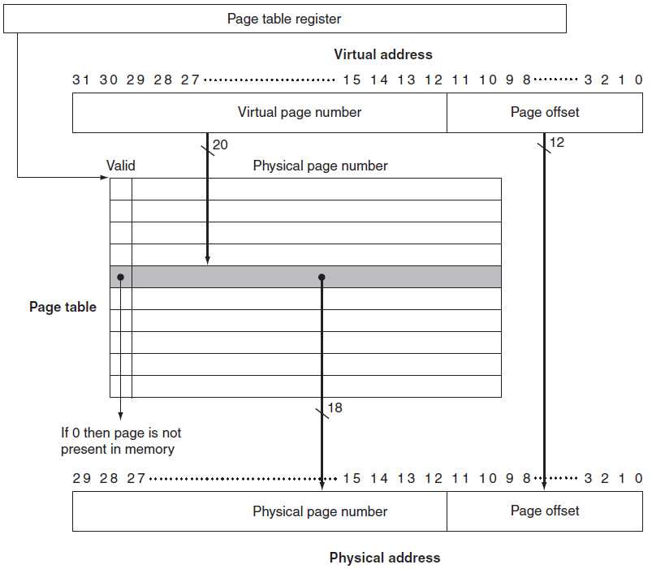
The page table
Each process has such register.
OS algorithm determines the physical page number.

Slide 23
The physical page bit-width is extended to 32 for ease of indexing. The extra bits are used to store additional information.
The OS creates the space on disk for all the pages of a process when it creates the process.
This disk space is called the swap space.
OS also creates a data structure to record where each virtual page is stored on disk.
It may be part of the page table or an auxiliary data structure indexed in the same way as the page table.

Slide 24
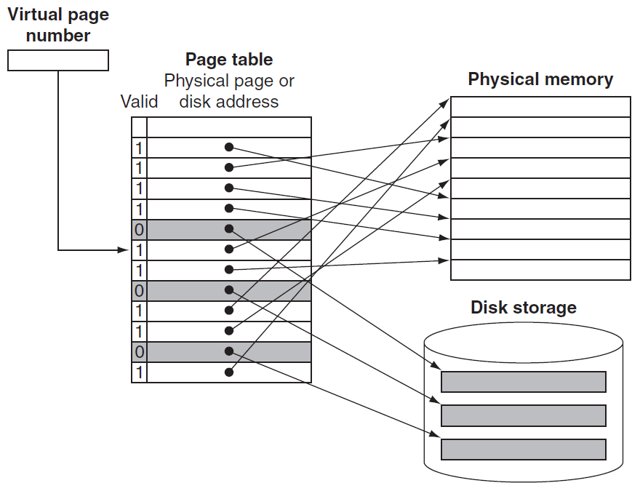
The page table maps each VM page to either a page in main memory or a page stored on disk.
Virtual page number is used to index the page table.
frame
frame
frame
frame
Valid bit 0: the page currently resides only on disk, at a specified disk address.

Slide 25
OS handles data structure to track which processes and which virtual addresses use each physical page.
The OS is another process, and these tables controlling memory reside in memory.
When all the pages in main memory are in use, the OS chooses a page to replace. Replaced pages are written to swap space on the disk.
To minimize the number of page faults LRU is used. But it is too expensive, requiring updating a data structure on every memory reference. Instead, an approximation is used.

Slide 26
Some computers provide a use bit or reference bit, (in HW) which is set whenever a page is accessed.
OS periodically clears the use bits and records them. It can determine which pages were touched during a certain time period.
OS then evicts a page whose reference bit is off.
With 32-bit virtual address, 4 KB page size, and 4 bytes per page table entry, the total page table size is: # page table entries = 2³² / 2¹² = 2²⁰.
Size of page table = 2²⁰ x 4bytes = 4MB (for every process! There may be 100’s!)

Slide 27
Writes in Virtual Memory
Access time difference between cache and main memory is 10’s – 100’s cycles. Write-through with a write buffer to hide the latency of the write from the processor worked.
In a VM system, writes to disk take millions processor cycles, so write-through is impractical.
Write-back, called copy back, is copying the page back to disk when it is replaced in the memory.
Disk transfer time is small compared to access time, so copy back is far more efficient than write-through.

Slide 28
A write-back is still costly.
We would like to know whether at a replacement the page needs to be copied back.
A dirty bit is added to the page table, being set when any word in a page is written.
The dirty bit indicates whether the page needs to be written out before its location in memory can be given to another page.

Slide 29
Paging replacement algorithms
OPT(MIN) : eliminate the page that be not expected to be used.
FIFO(first input/first output) : rather than choosing the victim page at random, the oldest page is the first to be removed.
LRU(Least Recently used) : move out the page that is oldest in terms of usage.
LFU(Least Frequently used) : move out the page that is not used often in the past.
MRU (Most recently used) : move out the page that is newest I n terms of usage.

Slide 30
Belady’s anamoly
It’s the phenomenon that increasing the number of page frames results in an increase in the number of page faults for a given memory access pattern.
FIFO and MRU policies suffer from this anamoly whereas LRU and optimal do not have this problem

